Slide 1
Standardized
Multiple Regression
Given a fitted multiple regression model, a user may want to compare the magnitudes of the effects of predictors on the response variable.
For example, for a model for gas consumption of a car with the car weight and horsepower as predictors, we want to know which predictor has a larger effect on consumption.
However, the magnitudes of the b_{j}‘s can not be compared directly since they depend on the units of the predictor.

Slide 2

Standardized
Multiple Regression
For example, when considering the fitted model
one may be tempted to conclude that X₁ is the only important predictor and that X₂ has little effect on Y.
We need to be wary of this since we do not know the units involved. Suppose the units are: Y in dollars, X₁ in thousand dollars and X₂ in cents.
A $1,000 increase in X₁ (i.e. a 1-unit increase), when X₂ is constant, would result in a $20,000 increase in the mean response.

Slide 3
Standardized
Multiple Regression
$1,000 increase in X₂ (a 100,000-unit increase), when X₁ is constant, would also result in a $20,000 increase in the mean response.
They both have the same magnitude of effect on Y despite their different coefficient values, due to different units.
Standardized regression coefficients may be used to judge the importance of different predictors.
They are the LSE parameter estimates obtained by running a regression on standardized variables.

Slide 4
Standardized
Multiple Regression
Standardization of a variable involves centering and scaling the variable.
Centering involves taking the difference between each observation and the mean of all the observations for the variable.
Scaling involves expressing the centered observations in units of the standard deviations of the observations for the variable.
This tells us how many standard deviations away from the mean each observation is.

Slide 5
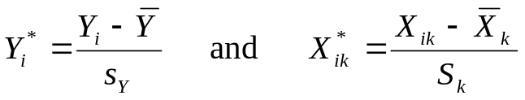
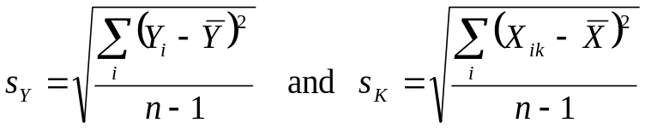
Standardized
Multiple Regression
The usual standardizations of the response variable and the predictor variables are
s_{y} and s_{k} are the respective standard deviations defined as

Slide 6

Standardized
Multiple Regression
The standardized regression model then uses these transformed variables in place of the original variables
The reason why there is no intercept is the least squares or maximum likelihood estimate of the intercept is always zero in the standardized regression model.

Slide 7
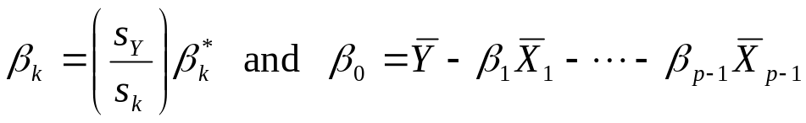
Standardized
Multiple Regression
The parameters in the standardized regression model and the parameters in the original model are related to each other as
Thus, the standardized regression coefficients and the original regression coefficients are related by simple scaling factors involving ratios of standard deviations.

Slide 8
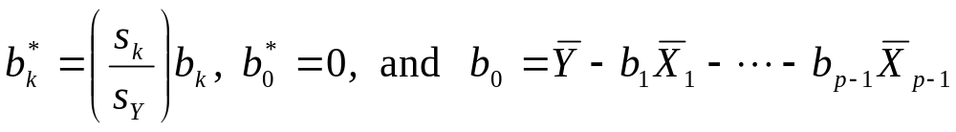
Standardized
Multiple Regression
The estimated regression coefficients for the standardized regression model can also be calculated from the estimated regression coefficients for the unstandardized regression model (and vice versa)
Consider the following example where the number of salespeople (X₁) and the amount of sales expenditures in millions of dollars (X₂) are the predictor variables and the amount of revenues in millions of dollars (Y) is the response variable.
To calculate the standardized regression coefficients, we can run a regression of Y on X₁ and X₂ to get the unstandardized regression coefficients.

Slide 9
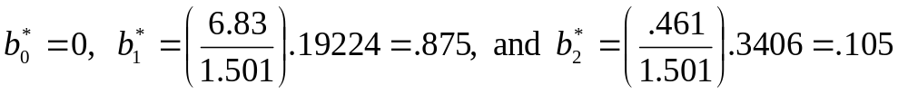
Standardized
Multiple Regression
Then we can standardize the regression coefficients. For this dataset, b₀ = -2.6062 ,b₁ = .19224 and b₂ = .3406.
Therefore, the unstandardized regression equation is
Y = -2.6062 + .19224X₁ +.3406X₂
We also have that, S_{Y} = 1.501, S₁ = 6.83 ,and S₂ = .461. Thus
Therefore, the standardized regression equation is
Y = .875X*₁ +.105X*₂
sas- standardize reg

